Slide 1
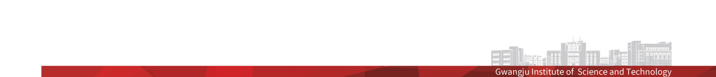
논문 미팅
Out of Distribution Detection (OOD) in 2018
Enhancing the reliability of Out-Of-Distribution image detection in neural networks (2018, ICLR)
Training confidence-calibrated classifiers for detecting Out-Of-Distribution samples (2018, ICLR)
광주과학기술원, 인공지능 연구실
신 성 호

Slide 2
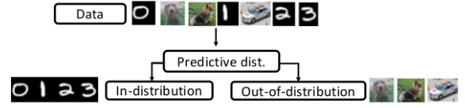
1
Out-of-Distribution Problem
Out-of-Distribution Detection (OOD)
Detecting the Out-of-Distribution samples, which are not used for training, from the inputs
Usually, Deep Neural Network show overconfident result for the unknown input.
MNIST classifier produce high confident probability 91% even for random noise [1]
Even for the new kinds of input, softmax rshow distinguishable probability distribution [2]

Slide 3
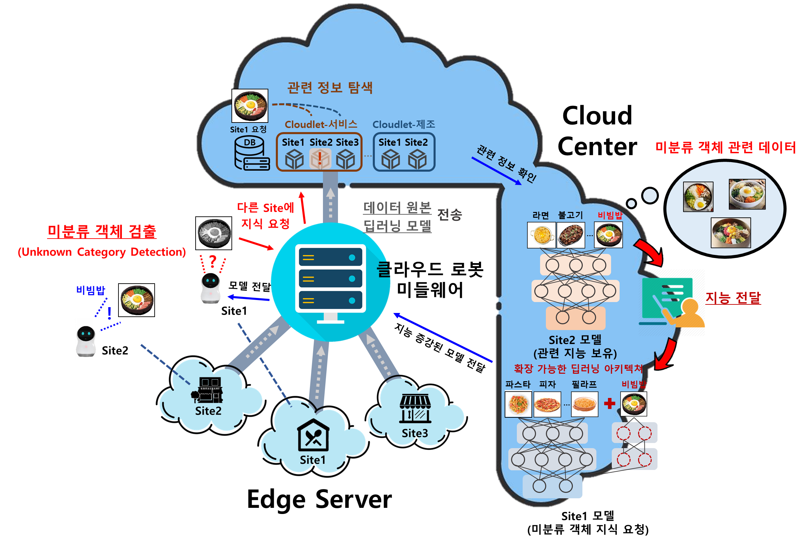
1
Out-of-Distribution Problem

Slide 4
2
Out-of-Distribution Problem
Enhancing the reliability of Out-Of-Distribution image detection in neural networks
Out-of-Distribution Detection without further re-training networks
Well trained network tends to assign higher softmax scores to in-distribution sample than out-of-distribution examples
(Contribution) To separate between in- and out-of-distribution samples …
Temperature scaling in the softmax function [3]
Adding small controlled perturbations to inputs [4]

Slide 5
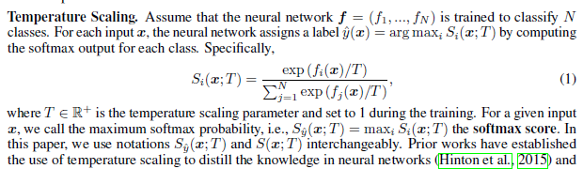
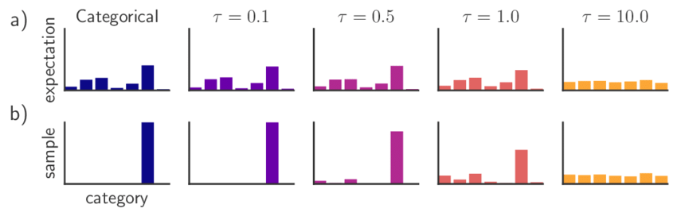
2
Out-of-Distribution Problem
- Enhancing the reliability of Out-Of-Distribution image detection in neural networks
Temperature scaling in the softmax function
For smoothing the probability distribution for each class
Out-of-distribution samples affects much more than the in-distribution samples

Slide 6
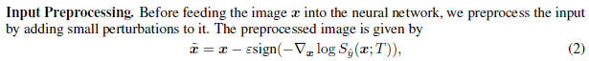

2
Out-of-Distribution Problem
- Enhancing the reliability of Out-Of-Distribution image detection in neural networks
Adding small controlled perturbations to inputs
Aim to increase the softmax score of any given input, without the need for a class label
Perturbations have stronger effect on the in-distribution images than out- samples
Out-of-Distribution Detector
The OOD detection is based on threshold, manually set.
➔ Direction of decreasing maximum softmax probability

Slide 7
2
Out-of-Distribution Problem
- Enhancing the reliability of Out-Of-Distribution image detection in neural networks
Dataset
(External Data) – Cropped or Down sampled
TinyImageNet : a subset of ImageNet, containing 10,000 test images from 200 different classes
LSUN : Large-scale Scene Understanding dataset, containing 10,000 images for 10 different scenes.
iSUN : a subset of SUN images, including 8925 images.
(Synthetic Data)
Gaussian Noise : Synthetic Gaussian noise dataset consists of 10,000 random 2D Gaussian noise images
Uniform Noise : Synthetic uniform noise dataset consists of 10,000 images where each RGB value of
every pixel is independently sampled from a uniform distribution on [0; 1].

Slide 8
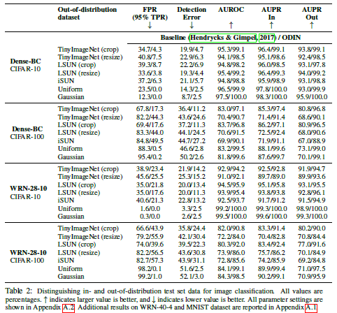
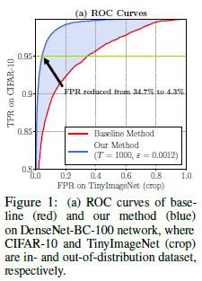
2
Out-of-Distribution Problem
- Enhancing the reliability of Out-Of-Distribution image detection in neural networks
Experimental Result

Slide 9
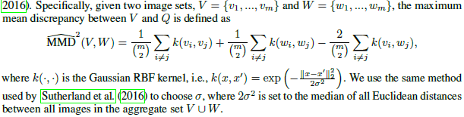
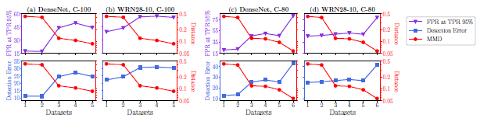
2
Out-of-Distribution Problem
- Enhancing the reliability of Out-Of-Distribution image detection in neural networks
Experimental Result
MMD : To measure the statistical distance between in- and out-of-distribution datasets
Negative relationship between MMD and the performances of proposed method

Slide 10
3
Out-of-Distribution Problem
Training confidence-calibrated classifiers for detecting Out-Of-Distribution samples
Developed new training scheme for OOD detection
Before threshold-based method depend on the performances of pre-trained classifier
(Contribution) To separate between in- and out-of-distribution samples …
Developed new-loss : confidence loss
Generates the OOD samples without using any Out-of-Distribution inputs

Slide 11
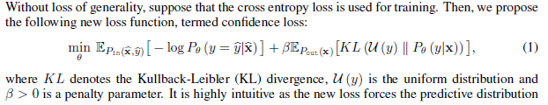
3
Out-of-Distribution Problem
- Training confidence-calibrated classifiers for detecting Out-Of-Distribution samples
Developed new-loss : confidence loss
Minimize the KL divergence from the predictive distribution on out-of-distribution samples to the uniform in order to give less confident predictions

Slide 12
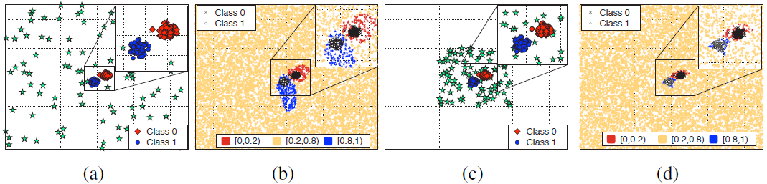
3
Out-of-Distribution Problem
- Training confidence-calibrated classifiers for detecting Out-Of-Distribution samples
Generates the OOD samples without using any Out-of-Distribution inputs
A prioi knowledge on out-of-distribution is not available or its underlying space is too huge to cover
Generate the most effective samples
Generate the ‘boundary’ samples in the low-density area of in-distribution samples
Intuition
Effect of boundary of in-distribution region might propagate to the entire out-of-distribution space

Slide 13
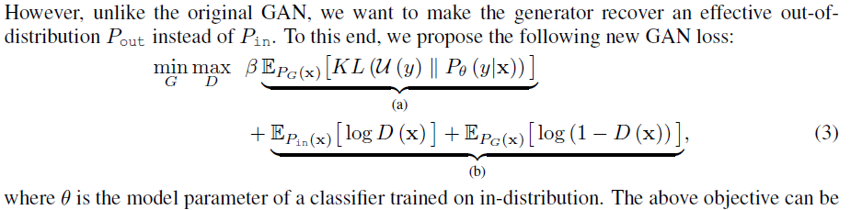
3
Out-of-Distribution Problem
- Training confidence-calibrated classifiers for detecting Out-Of-Distribution samples
Generates the OOD samples without using any Out-of-Distribution inputs
GAN loss for generating the OOD samples in the boundary of in-distribution samples
(a) : Forces the generator to generate low-density samples since it can be interpreted as minimizing the log negative likelihood of in-distribution (push)
(b) : Forces having samples being not too far from the in-distribution samples (pull)

Slide 14
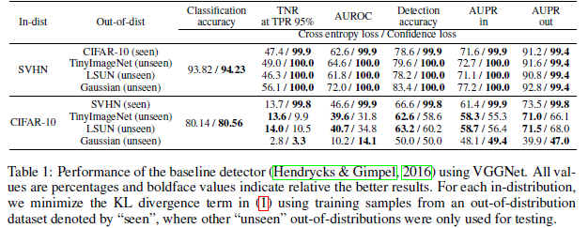
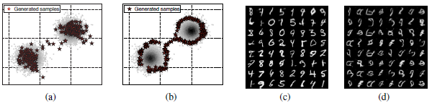
3
Out-of-Distribution Problem
- Enhancing the reliability of Out-Of-Distribution image detection in neural networks
Experimental Result
Effects of confidence loss

